Slide 1


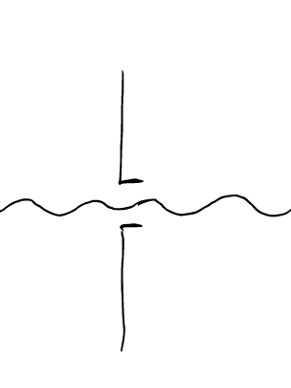

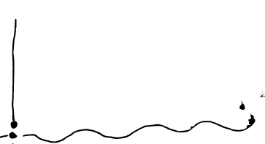
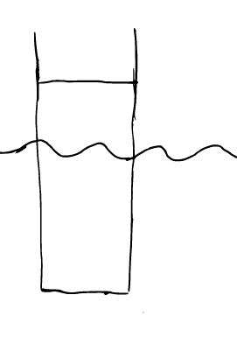
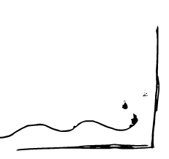
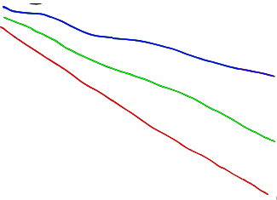
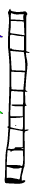



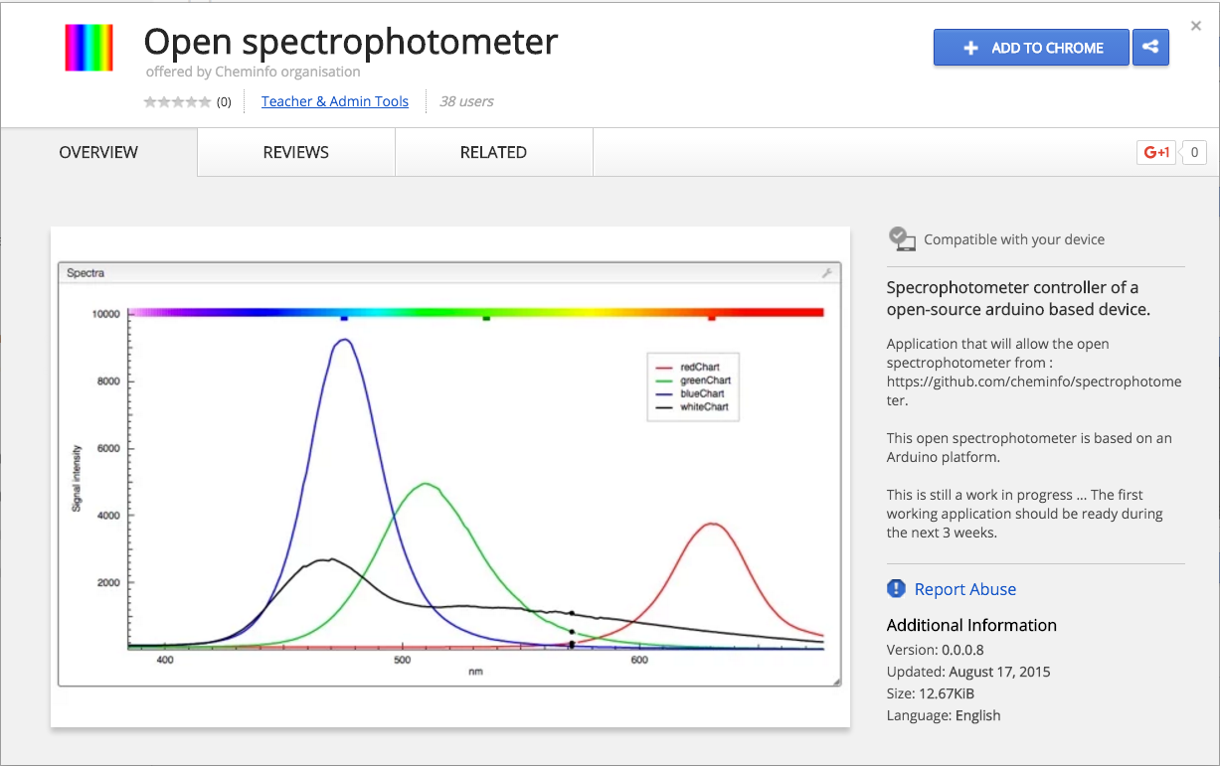
open-spectrophotometer
Florian, Océane and Luc Patiny, Michaël Zasso
HOW ?
Open hardware, open software
https://github.com/open-spectro
Principle
The light produced by white LEDs goes through a sample, is selected by 2 slits and diffracted by a grating film. The diffracted light is analysed by a photodiode array that is connected to the computer.
Hardware
256 pixels photodiode array
mini USB
2 white LEDs
1 RGB LED
ATMEGA 32U4
16MHz clock
Compact PCB are designed to use the same micro controller as the Arduino™ Leonardo and is fully compatible with the Arduino™ IDE. This makes it very easy to program.
Communication with the spectrophotometer is done using USB virtual serial port allowing simple control from any program.
Software
3D printed box with a precision of 0.1 mm allows precise installation of the electronic and grating film.
A chrome application allows to control directly the spectrophotometer from the computer in order to calibrate, acquire and process the data.

Slide 2
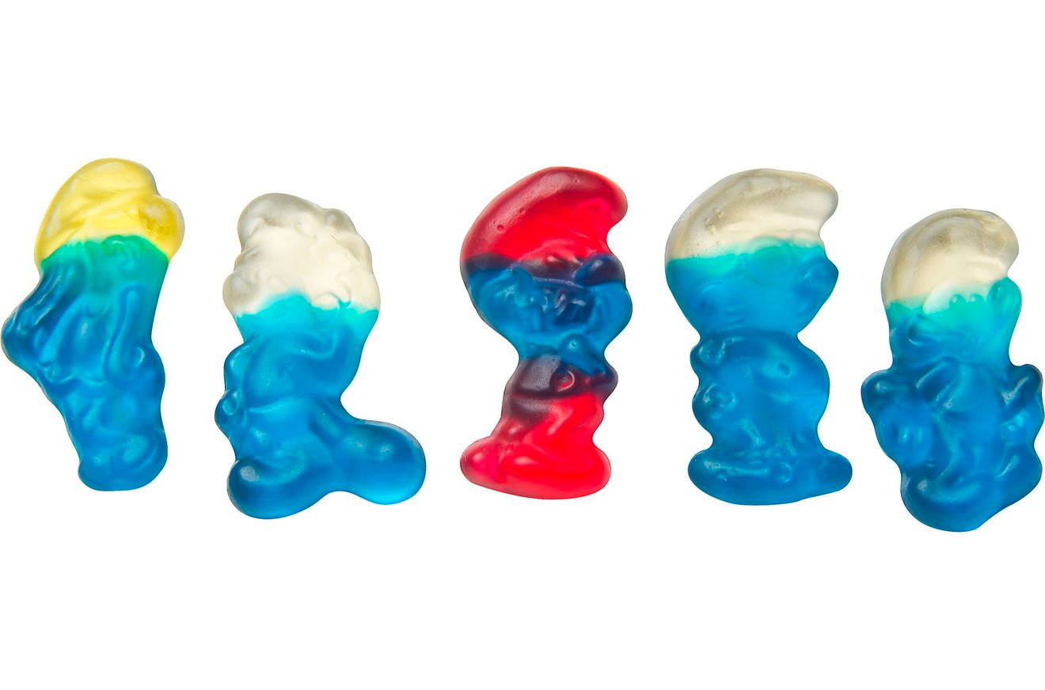
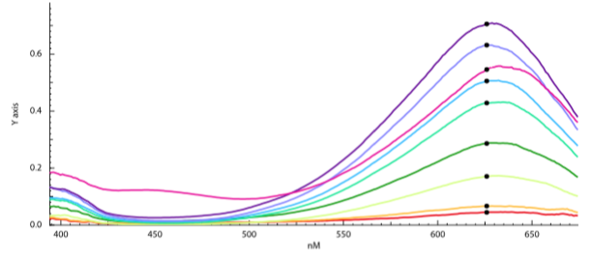
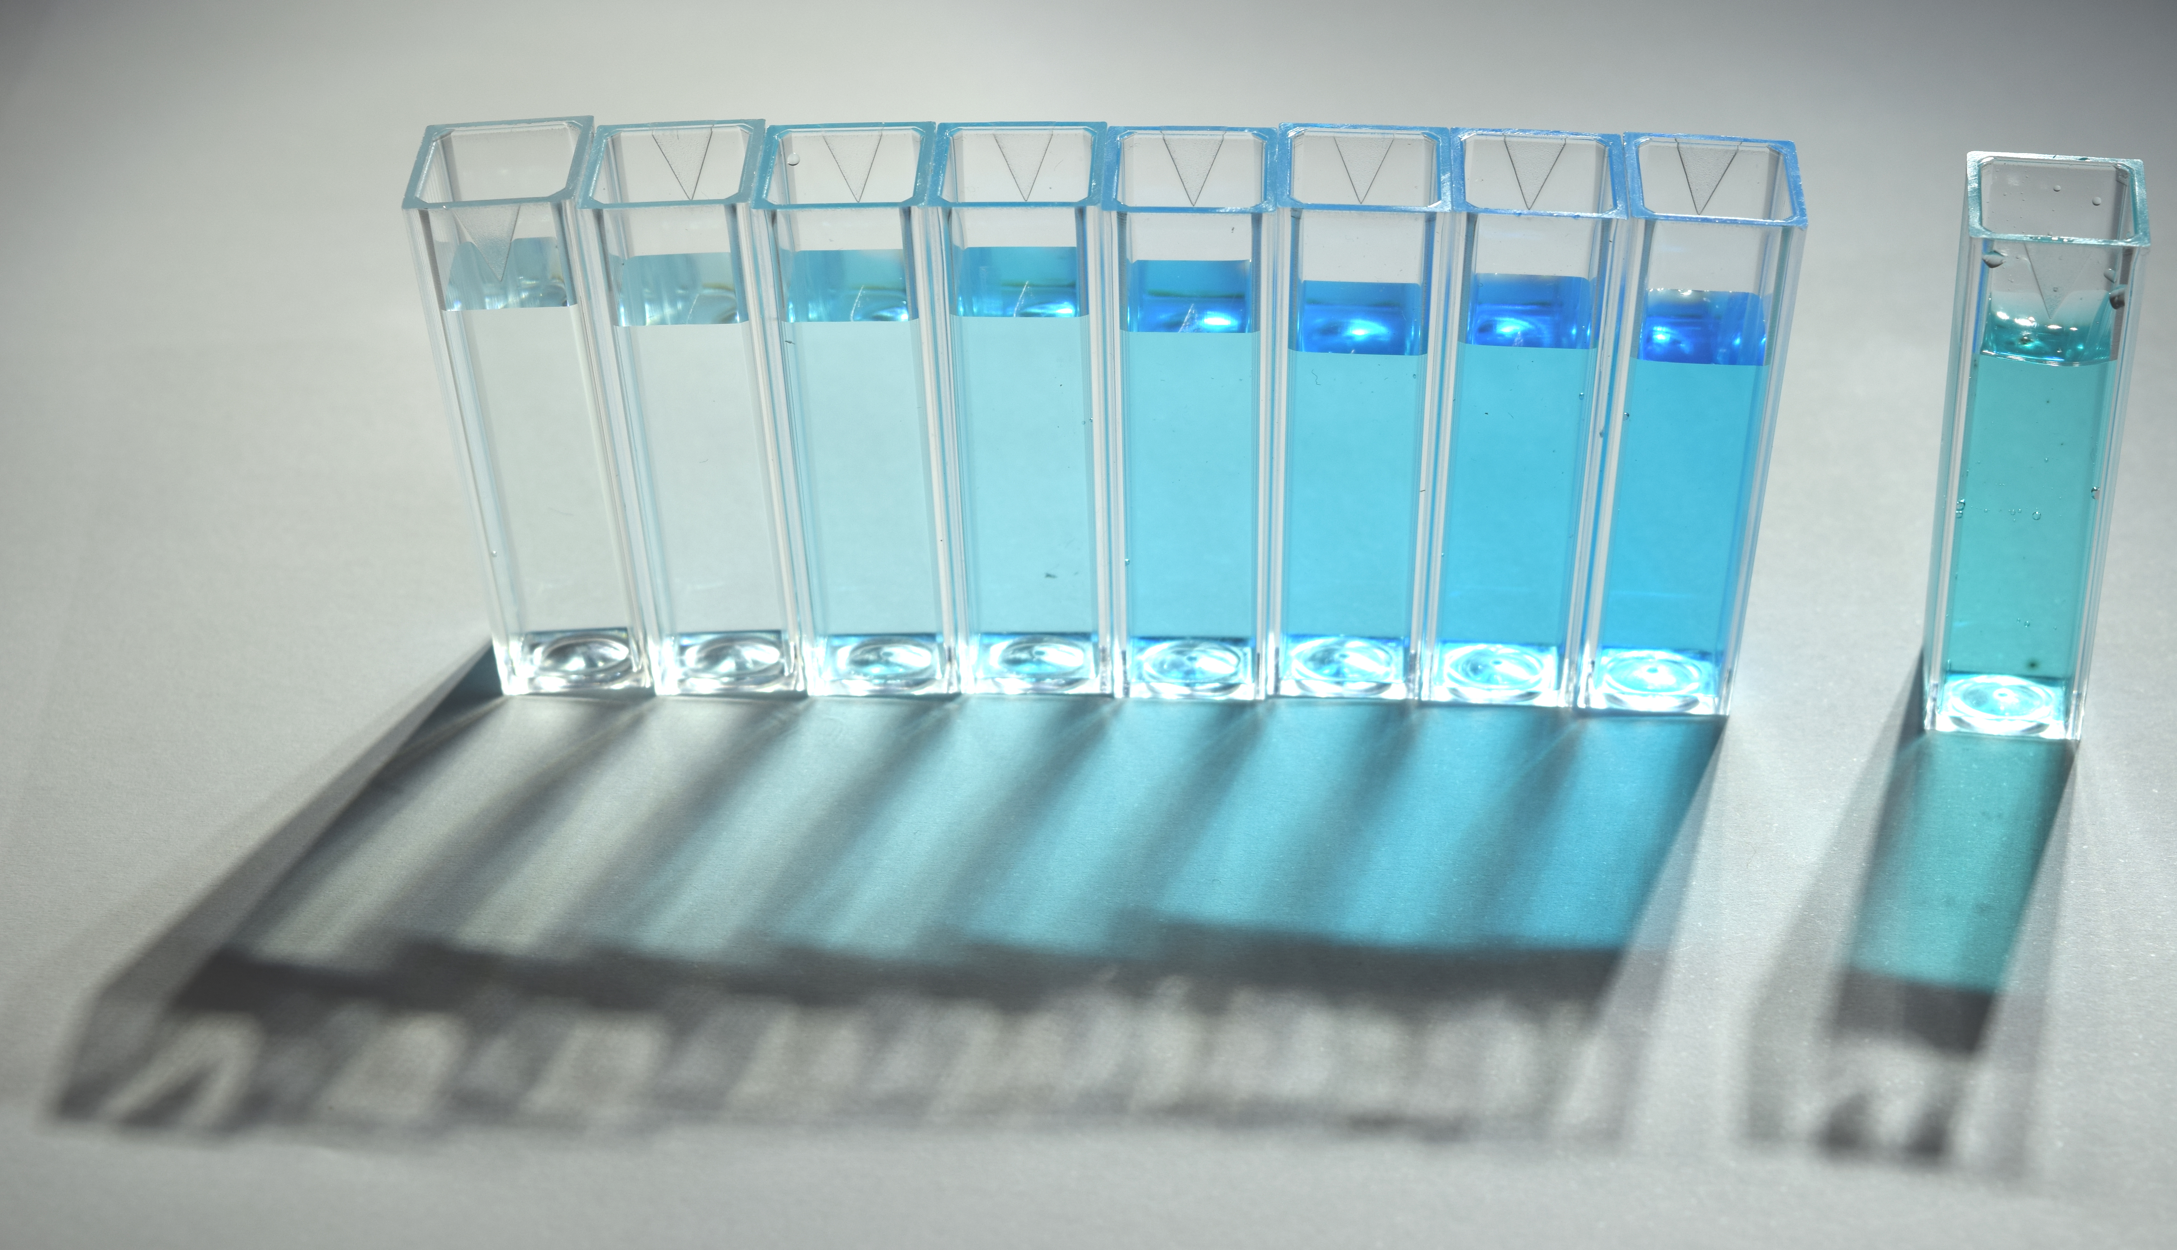
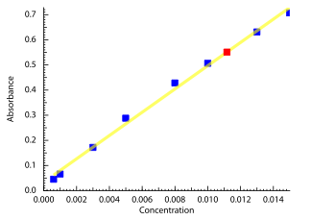
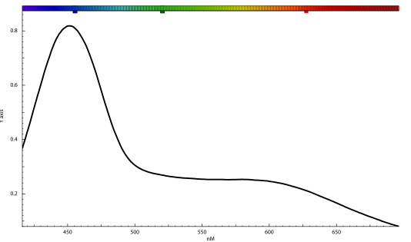
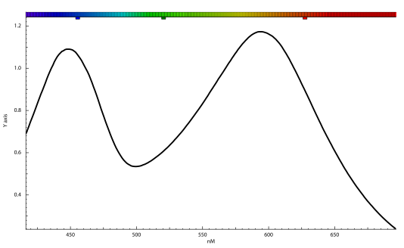
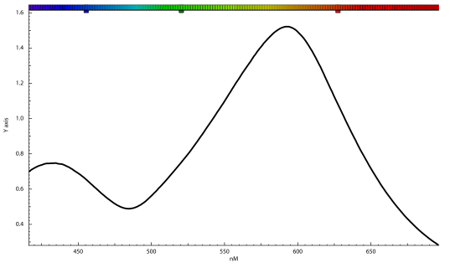
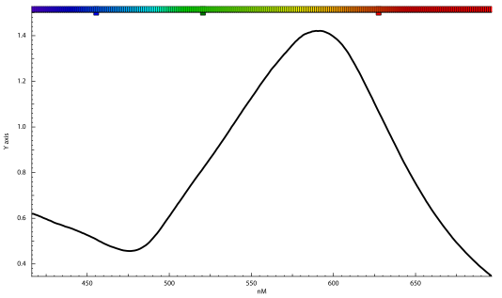
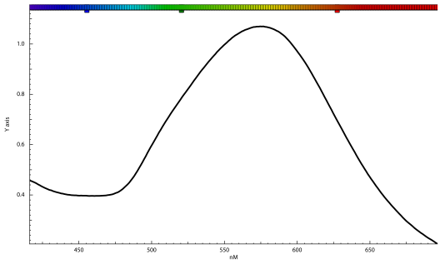
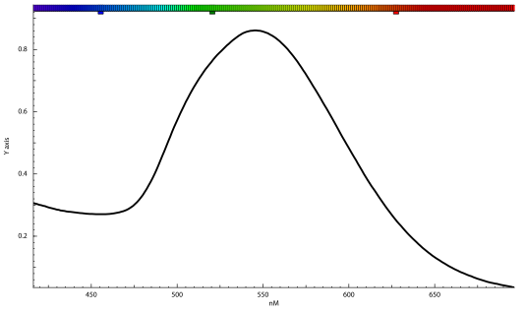
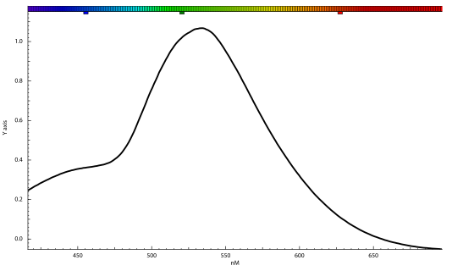
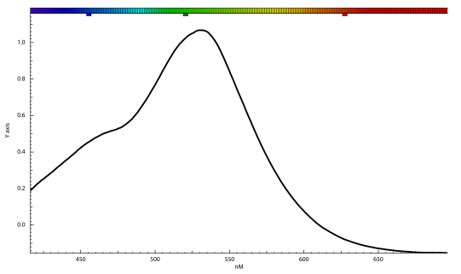
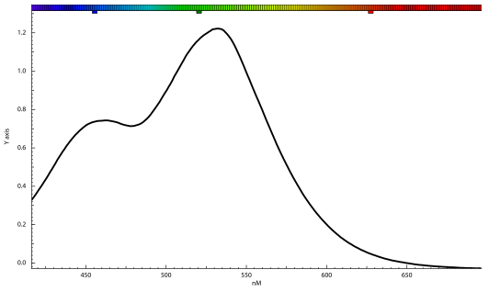
open-spectrophotometer
Florian, Océane and Luc Patiny, Michaël Zasso
WHAT FOR ?
Simple design to understand how a spectrophotometer works, but precise enough to make real experiments.
Very cheap and accessible to everyone.
Determination of pigments concentration
Blue patent V is the pigment that is present in Haribo smurfs sweets. Using a calibration curve with the pure pigment it is possible to determine the amount of colorant present in the sweets.
Linear regression
Slope: 46.12
Intercept: 0.03
R: 0.9973
R²: 0.9946
Left: reference solutions. Right: Haribo
Calibration curve. In red the unknown.
Determination of pH using red cabbage
Chopped red cabbage was cooked in boiling water for 10 minutes to yield after filtration to a dark purple liquid.
The liquid was diluted by a factor 3 with water and either tartaric acid or sodium carbonate where added in various quantities to obtain a large color palette.
Red: acid, green: basic
Absorbance spectra of the 9 solutions

